Slide 1
C H A P T E R 8
More About Strings

Slide 2
Topics
Basic String Operations
String Slicing
Testing, Searching, and Manipulating Strings

Slide 3
Basic String Operations
Many types of programs perform operations on strings
In Python, many tools for examining and manipulating strings
Strings are sequences, so many of the tools that work with sequences work with strings

Slide 4
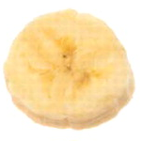
Accessing the Individual Characters in a String
To access an individual character in a string:
Use a for loop
Format: for character in string:
Useful when need to iterate over the whole string, such as to count the occurrences of a specific character
Use indexing
Each character has an index specifying its position in the string, starting at 0
Format: character = my_string[i]

Slide 5
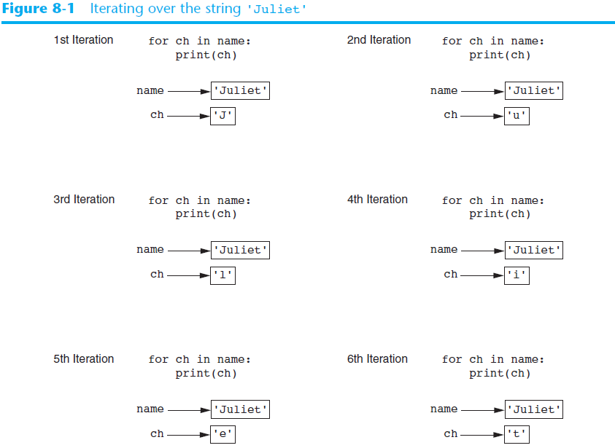

Slide 6
# This program counts the number of times
# the letter T (uppercase or lowercase)
# appears in a string.
def main():
# Create a variable to use to hold the count.
# The variable must start with 0.
count = 0
# Get a string from the user.
my_string = input('Enter a sentence: ')
# Count the Ts.
for ch in my_string:
if ch == 'T' or ch == 't':
count += 1
# Print the result.
print('The letter T appears', count, 'times.')
# Call the main function.
main()

Slide 7
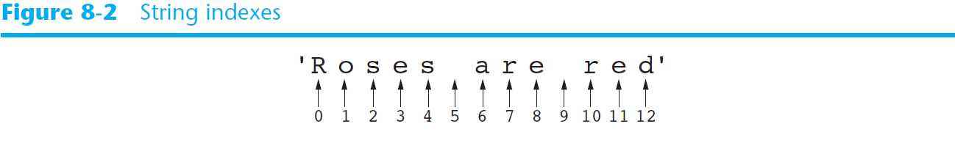
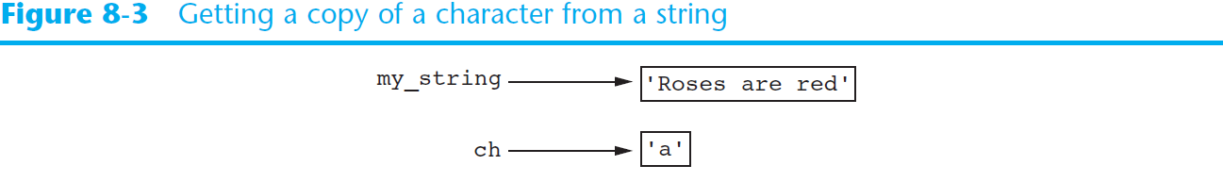
Accessing the Individual Characters in a String (cont’d.)
When setting ch=my_string[6]

Slide 8
Accessing the Individual Characters in a String (cont’d.)
IndexError exception will occur if:
You try to use an index that is out of range for the string
Likely to happen when loop iterates beyond the end of the string
len(string) function can be used to obtain the length of a string
Useful to prevent loops from iterating beyond the end of a string

Slide 9
String Concatenation
Concatenation: appending one string to the end of another string
Use the + operator to produce a string that is a combination of its operands
The augmented assignment operator += can also be used to concatenate strings
The operand on the left side of the += operator must be an existing variable; otherwise, an exception is raised

Slide 10
Strings Are Immutable
Strings are immutable
Once they are created, they cannot be changed
Concatenation doesn’t actually change the existing string, but rather creates a new string and assigns the new string to the previously used variable
Cannot use an expression of the form
string[index] = new_character
Statement of this type will raise an exception

Slide 11
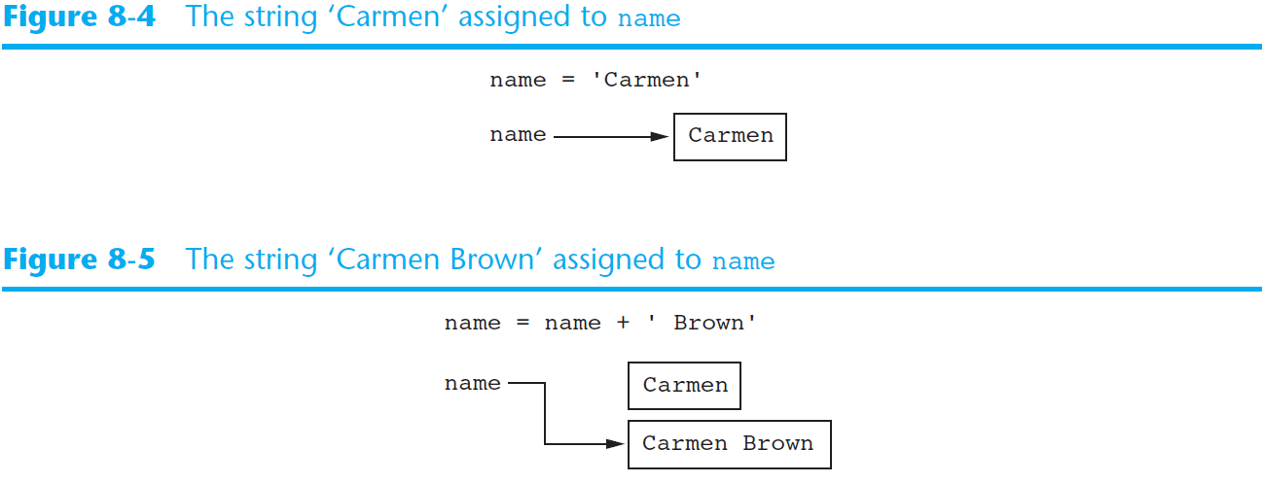
Strings Are Immutable (cont’d.)
def main():
name = 'Carmen'
print('The name is', name)
name = name + ' Brown'
print('Now the name is', name)
# Call the main function.
main()

Slide 12
String Slicing
Slice: span of items taken from a sequence, known as substring
Slicing format: string[start : end]
Expression will return a string containing a copy of the characters from start up to, but not including, end
If start not specified, 0 is used for start index
If end not specified, len(string) is used for end index
Slicing expressions can include a step value and negative indexes relative to end of string

Slide 13
>>> full_name = 'Patty Lynn Smith'
>>> middle_name = full_name[6:10]
>>> print (middle_name)
Lynn
>>> first_name = full_name[:5]
>>> print (first_name)
Patty
>>> last_name = full_name[11:]
>>> print (last_name)
Smith
>>> mystring = full_name[0:len(full_name)]
>>> print (my_string)
>>> print (mystring)
Patty Lynn Smith
>>> print (full_name[0:len(full_name):2])
PtyLn mt
>>>

Slide 14
Testing, Searching, and Manipulating Strings
You can use the in operator to determine whether one string is contained in another string
General format: string1 in string2
string1 and string2 can be string literals or variables referencing strings
Similarly you can use the not in operator to determine whether one string is not contained in another string

Slide 15
>>> text = 'Four score and seven years ago'
>>> 'seven' in text
True
>>> 'ok' in text
False
>>> 'seve' in text
True
>>> 'e ' in text
True
>>> 'Seven' in text
False

Slide 16
String Methods
Strings in Python have many types of methods, divided into different types of operations
General format: mystring.method(arguments)
Some methods test a string for specific characteristics
Generally Boolean methods, that return True if a condition exists, and False otherwise

Slide 17
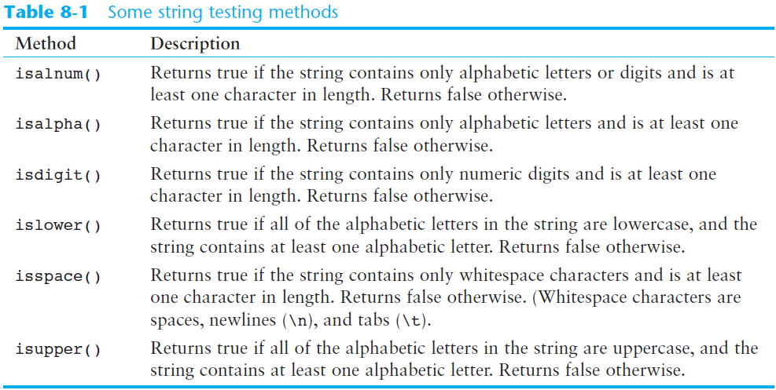
String Methods (cont’d.)

Slide 18
def main():
# Get a string from the user.
user_string = input('Enter a string: ')
print('This is what I found about that string:')
# Test the string.
if user_string.isalnum():
print('The string is alphanumeric.')
if user_string.isdigit():
print('The string contains only digits.')
if user_string.isalpha():
print('The string contains only alphabetic characters.')
if user_string.isspace():
print('The string contains only whitespace characters.')
if user_string.islower():
print('The letters in the string are all lowercase.')
if user_string.isupper():
print('The letters in the string are all uppercase.')
# Call the main function.
main();

Slide 19
String Methods (cont’d.)
Some methods return a copy of the string, to which modifications have been made
Simulate strings as mutable objects
String comparisons are case-sensitive
Uppercase characters are distinguished from lowercase characters
lower and upper methods can be used for making case-insensitive string comparisons

Slide 20
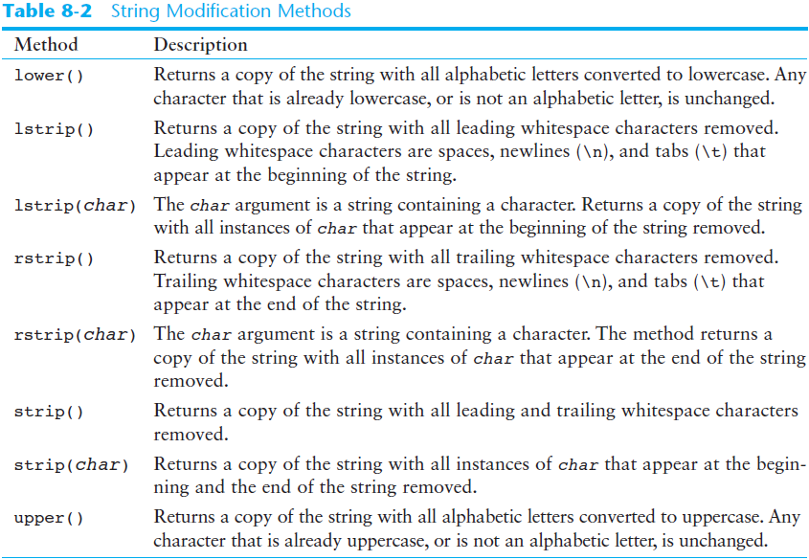
>>> letters = 'WXYZ'
>>> print(letters, letters.lower())
WXYZ wxyz

Slide 21
String Methods (cont’d.)
Programs commonly need to search for substrings
Several methods to accomplish this:
endswith(substring): checks if the string ends with substring
Returns True or False
startswith(substring): checks if the string starts with substring
Returns True or False

Slide 22
String Methods (cont’d.)
Several methods to accomplish this (cont’d):
find(substring): searches for substring within the string
Returns lowest index of the substring, or if the substring is not contained in the string, returns -1
replace(substring, new_string):
Returns a copy of the string where every occurrence of substring is replaced with new_string

Slide 23
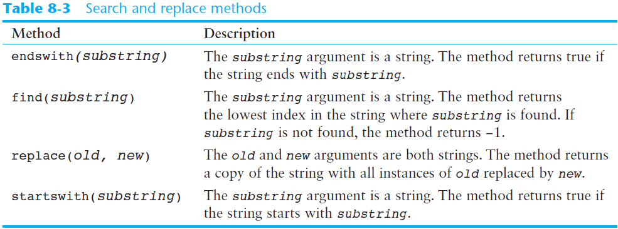
>>> filename = input('enter file name')
enter file name AA.py
>>> if filename.endswith('.py'):
... print('This is a python file')
...
This is a python file
>>>

Slide 24
The Repetition Operator
Repetition operator: makes multiple copies of a string and joins them together
The * symbol is a repetition operator when applied to a string and an integer
String is left operand; number is right
General format: string_to_copy * n
Variable references a new string which contains multiple copies of the original string

Slide 25
Splitting a String
split method: returns a list containing the words in the string
By default, uses space as separator
Can specify a different separator by passing it as an argument to the split method

Slide 26
# This program demonstrates the split method.
def main():
# Create a string with multiple words.
my_string = 'One two three four'
# Split the string.
word_list = my_string.split()
# Print the list of words.
print(word_list)
# Call the main function.
main()

Slide 27
# This program calls the split method, using the
# '/' character as a separator.
def main():
# Create a string with a date.
date_string = '11/26/2012'
# Split the date.
date_list = date_string.split('/')
# Display each piece of the date.
print('Month:', date_list[0])
print('Day:', date_list[1])
print('Year:', date_list[2])
# Call the main function.
main()

Slide 28
Summary
This chapter covered:
String operations, including:
Methods for iterating over strings
Repetition and concatenation operators
Strings as immutable objects
Slicing strings and testing strings
String methods
Splitting a string

Slide 29
C H A P T E R 9
Dictionaries and Sets

Slide 30
Topics
Dictionaries
Serializing Objects

Slide 31
Dictionaries
Dictionary: object that stores a collection of data
Each element consists of a key and a value
Often referred to as mapping of key to value
Key must be an immutable object
To retrieve a specific value, use the key associated with it
Format for creating a dictionary
dictionary =
{key1:val1, key2:val2}

Slide 32
Retrieving a Value from a Dictionary
Elements in dictionary are unsorted
General format for retrieving value from dictionary: dictionary[key]
If key in the dictionary, associated value is returned, otherwise, KeyError exception is raised
Test whether a key is in a dictionary using the in and not in operators
Helps prevent KeyError exceptions

Slide 33
Adding Elements to an Existing Dictionary
Dictionaries are mutable objects
To add a new key-value pair:
dictionary[key] = value
If key exists in the dictionary, the value associated with it will be changed

Slide 34
Deleting Elements From an Existing Dictionary and len function
To delete a key-value pair:
del dictionary[key]
If key is not in the dictionary, KeyError exception is raised
len function: used to obtain number of elements in a dictionary

Slide 35
>>> phonebook={'chris':'111', 'katie':'222'}
>>> phonebook
{'chris': '111', 'katie': '222'}
>>> phonebook['chirs']
Traceback (most recent call last):
File "<stdin>", line 1, in <module>
KeyError: 'chirs'
>>> phonebook['chris']
'111'
>>> if 'chris' in phonebook:
... print(phonebook['chris'])
...
111
>>> phonebook['joe']= '333'
>>> phonebook
{'chris': '111', 'joe': '333', 'katie': '222'}
>>> del phonebook['chris']
>>> phonebook
{'joe': '333', 'katie': '222'}
>>> len(phonebook)
2

Slide 36
Getting the Number of Elements and Mixing Data Types
Keys must be immutable objects, but associated values can be any type of object
One dictionary can include keys of several different immutable types
Values stored in a single dictionary can be of different types
>>> test = {[1,2]:[1,2,3]}
Traceback (most recent call last):
File "<stdin>", line 1, in <module>
TypeError: unhashable type: 'list'

Slide 37
Creating an Empty Dictionary and Using for Loop to Iterate Over a Dictionary
To create an empty dictionary:
Use {}
Use built-in function dict()
Elements can be added to the dictionary as program executes
Use a for loop to iterate over a dictionary
General format: for key in dictionary:

Slide 38
>>> mixed_up = {'abc':1, 999:'yaya', (1,2):[23,33]}
>>> mixed_up
{(1, 2): [23, 33], 'abc': 1, 999: 'yaya'}
>>> phonebook = {}
>>> phonebook
{}
>>> phonebook['chris'] = '999'
>>> phonebook['bill'] = '888'
>>> phonebook
{'chris': '999', 'bill': '888'}
>>> for key in phonebook:
... print(key, phonebook[key])
...
chris 999
bill 888

Slide 39
Some Dictionary Methods
clear method: deletes all the elements in a dictionary, leaving it empty
Format: dictionary.clear()
get method: gets a value associated with specified key from the dictionary
Format: dictionary.get(key, default)
default is returned if key is not found
Alternative to [] operator
Cannot raise KeyError exception

Slide 40
Some Dictionary Methods (cont’d.)
items method: returns all the dictionaries keys and associated values
Format: dictionary.items()
Returned as a dictionary view
Each element in dictionary view is a tuple which contains a key and its associated value
Use a for loop to iterate over the tuples in the sequence
Can use a variable which receives a tuple, or can use two variables which receive key and value

Slide 41
Some Dictionary Methods (cont’d.)
keys method: returns all the dictionaries keys as a sequence
Format: dictionary.keys()
pop method: returns value associated with specified key and removes that key-value pair from the dictionary
Format: dictionary.pop(key, default)
default is returned if key is not found

Slide 42
Some Dictionary Methods (cont’d.)
popitem method: returns a randomly selected key-value pair and removes that key-value pair from the dictionary
Format: dictionary.popitem()
Key-value pair returned as a tuple
values method: returns all the dictionaries values as a sequence
Format: dictionary.values()
Use a for loop to iterate over the values

Slide 43
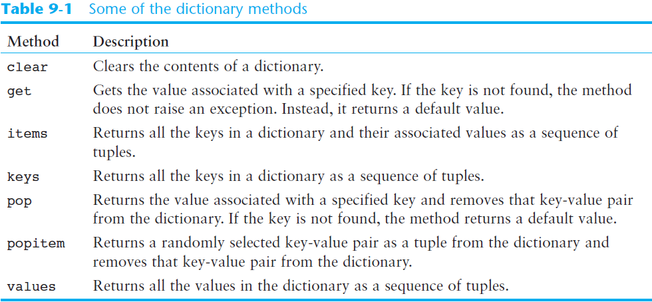
Some Dictionary Methods (cont’d.)

Slide 44
>>> value = phonebook.get('bill', 'not found')
>>> print(value)
888
>>> value = phonebook.get('andy', 'not found')
>>> print(value)
not found
>>> phonebook.items()
dict_items([('chris', '999'), ('bill', '888')])
>>> for name, phone in phonebook.items():
... print(name, phone)
...
chris 999
bill 888
>>> phonebook.keys()
dict_keys(['chris', 'bill'])
>>> phonebook.pop('chris', 'not found')
'999'
>>> phonebook
{'bill': '888'}

Slide 45
>>> phonebook['andy'] = '777'
>>> phonebook
{'andy': '777', 'bill': '888'}
>>> key, value = phonebook.popitem()
>>> print (key, value)
andy 777
>>> phonebook
{'bill': '888'}
>>> phonebook['andy'] = '777'
>>> phonebook['david'] = '444'
>>> phonebook.values()
dict_values(['777', '444', '888'])
>>> phonebook
{'andy': '777', 'david': '444', 'bill': '888'}
>>> phonebook.clear()
>>> phonebook
{}

Slide 46
Serializing Objects
Serialize an object: convert the object to a stream of bytes that can easily be stored in a file
Pickling: serializing an object

Slide 47
Serializing Objects (cont’d.)
To pickle an object:
Import the pickle module
Open a file for binary writing
Call the pickle.dump function
Format: pickle.dump(object, file)
Close the file
You can pickle multiple objects to one file prior to closing the file

Slide 48
Serializing Objects (cont’d.)
Unpickling: retrieving pickled object
To unpickle an object:
Import the pickle module
Open a file for binary writing
Call the pickle.load function
Format: pickle.load(file)
Close the file
You can unpickle multiple objects from the file

Slide 49
>>> import pickle
>>> phonebook = [{'chris':999}, {'david':888}, {'andy':111}]
>>> with open('phonebook.dat', 'wb’) as output_file:
>>> ....pickle.dump(phonebook, output_file)
mspan@stu-000000005:~$ ls
java phonebook.dat public_html python
mspan@stu-000000005:~$ more phonebook.dat
▒}q
>>> import pickle
>>> with open('phonebook.dat', 'rb’) as input_file:
>>> ....pb = pickle.load(input_file)
>>>
>>> pb
[{'chris':999}, {'david':888}, {'andy':111}]

Slide 50
Summary
This chapter covered:
Dictionaries, including:
Creating dictionaries
Inserting, retrieving, adding, and deleting key-value pairs
for loops and in and not in operators
Dictionary methods
Serializing objects
Pickling and unpickling objects

Slide 51
Notice
You should take the dictionary as a data structure
The data structure in python is dynamic
Use .get to access the dictionary in a more safe way
Use .items() to traverse all items in a dictionary

Slide 52
In our pretest
Given any string str_input, please count the number of individual character. For example, if the str_input is “aabbccaaccddeeeffwwgcceeda”, the result will be a: 5, b: 2, …..

Slide 53
Assignment
Maintain student’s data structure by a list

